Slide 1
Stance detection for political views regarding the 2020 Presidential Election in the
U.S.A.
Drobnitchi Daniel - 411
Suto Robert-Lucian - 411

Slide 2
TABLE OF CONTENTS
1
2
3
Introduction
Dataset
EDA
4
Processing Data
5
6
Conclusion
Training
The models

Slide 3
Introduction

Slide 4
INTRODUCTION
application of Natural Language Processing techniques to analyze and categorize text data based on political ideologies or beliefs
used in various fields such as politics, marketing, and social media analysis
It involves using algorithms to identify patterns and features in text data that can predict the author’s political beliefs or views on political issues.

Slide 5
DataSet
P-Stance dataset of the 2020 Presidential Election in USA. The dataset is organized based on the candidates : Donald Trump, Bernie Sanders, Joe Biden
Each Candidate has having 6500 training tweets and 800 testing
Each Tweet contains three columns, Tweet, Target and Stance

Slide 6
Examples of tweets:
Against - Donald Trump: Tell us something we didnt know. Bribery Corruption Obstruction. Thats his MO. #Trump
Pro - Donald Trump: Attorney General Bill Barr is a rotten piece of .#MuellerReport #BillBarr #Trump
Against - Joe Biden : #Biden can not command respect in this little room much less our nation
Pro - Joe Biden : Joe gives us solutions. Joe gives us a clear path forward while we navigate this global crisis. The next Commander-In-Chief, everyone #Twill
Against - Bernie Sanders : Well, a sad day for all my communist friends. I guess they are gonna have to move to Cuba or wait another 4-8 years #BernieSanders Feel the burn!!
Pro - Bernie Sanders I can legally change my address to MI and just did so I can volunteer vote for #BernieSanders in MI.
We decided to not use the candidate as a feature. This adds complexity to the way features are separated in the training part of the project, as it lacks crucial information in which it can build on.
It is important to take into account the relative bias a social media app has towards some of the candidates.

Slide 7
Exploratory data analysis

Slide 8
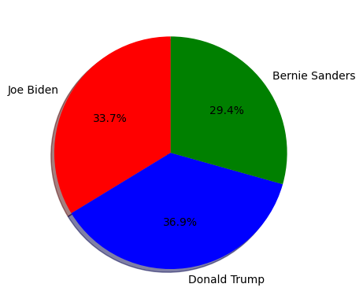
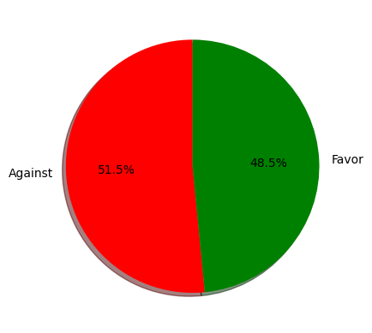
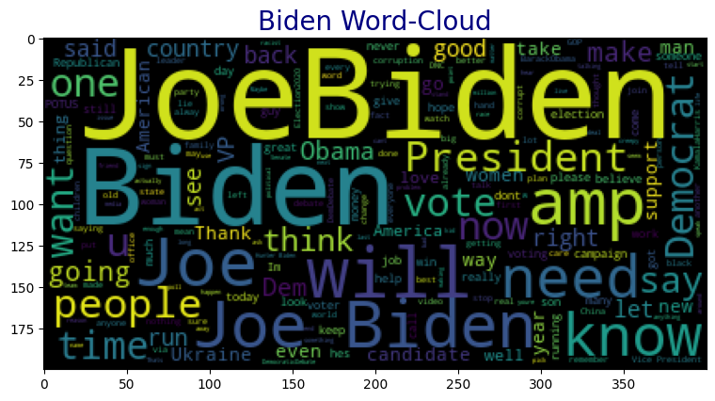
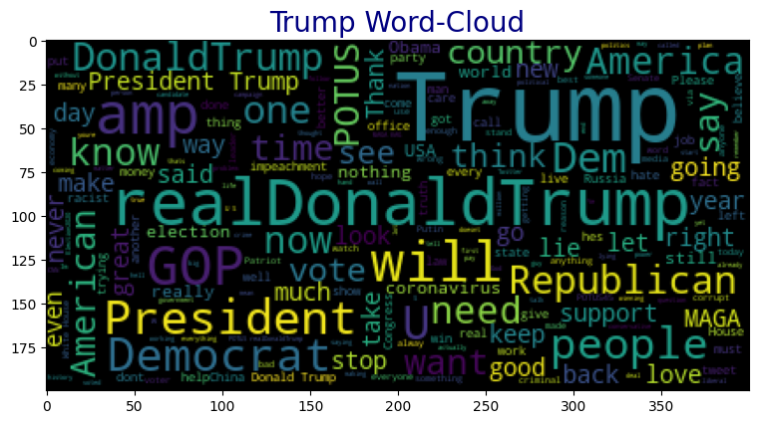
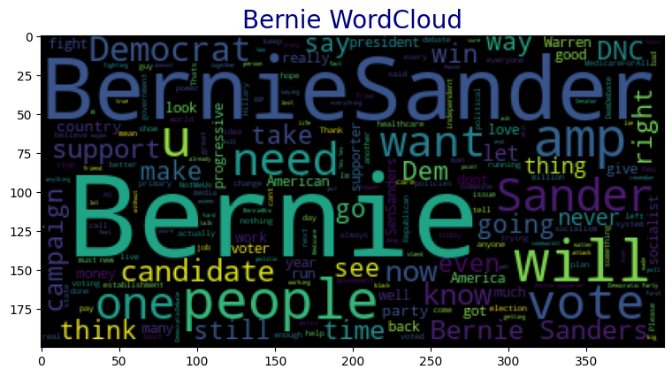
Distribution of Data
Word Clouds

Slide 9
Processing the data

Slide 10
What happened to the tweets?
Lowered all the characters.
Split the tweets into separate words.
Removed hashtags
Removed mentions from the words.
Stemmed each word using
Unidecoded the text.
Removed alphanumerical characters.
Removed whitespaces.

Slide 11
Training models

Slide 12
What models were used?
1
2
Support Vector Machine
Logistic Regression
3
4
5
Knn Neighbors
Multinomial Naive Bayes
Decision Tree Classifier

Slide 13
Accuracy
Model | Accuracy Train | Accuracy Test
Support Vector Machine | 55.9% | 69%
Logistic Regression | 59% | 68.7%
Knn Neighbors | 58.3% | 68.7%
Multinomial Naive Bayes | 57.9% | 61.7%
Decision Tree Classifier | 55.4% | 68.7%

Slide 14
Conclusion

Slide 15
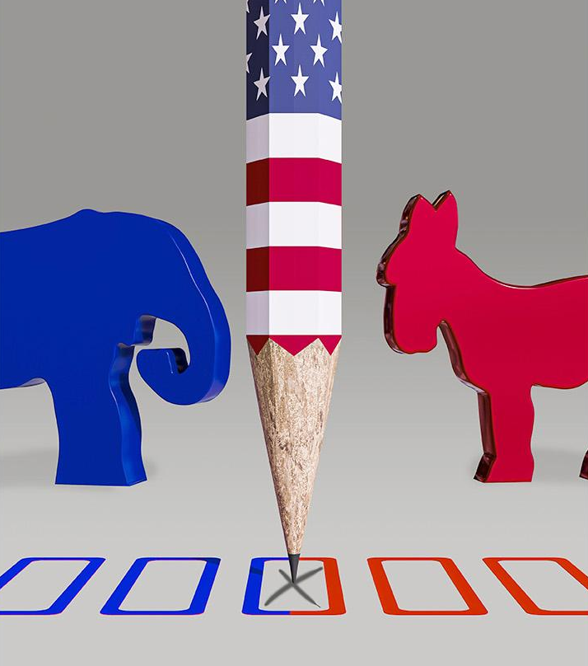
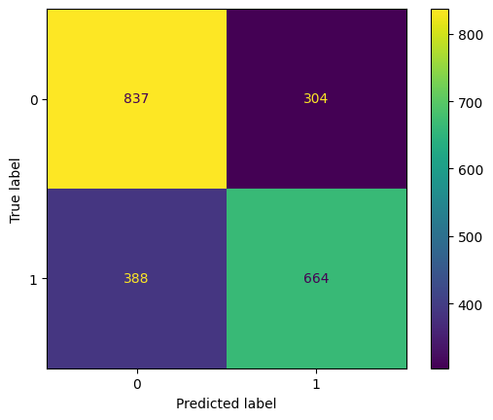
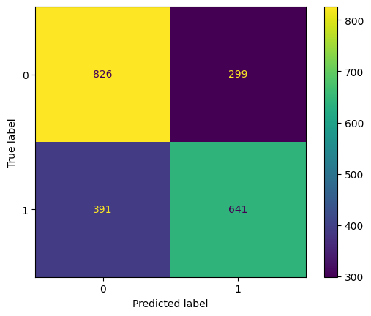
In conclusion, the results of the experiment showed that the best algorithm for predicting tweet sentiment towards political candidates was Support Vector Machines (SVM)
The algorithms have a tendency to predict tweets as being against a candidate, rather than in favor of them

Slide 16
THANKS, PRESIDENT!
Do you have any questions?
youremail@freepik.com
+91 620 421 838
yourwebsite.com
Please keep this slide for attribution

